Slide 1


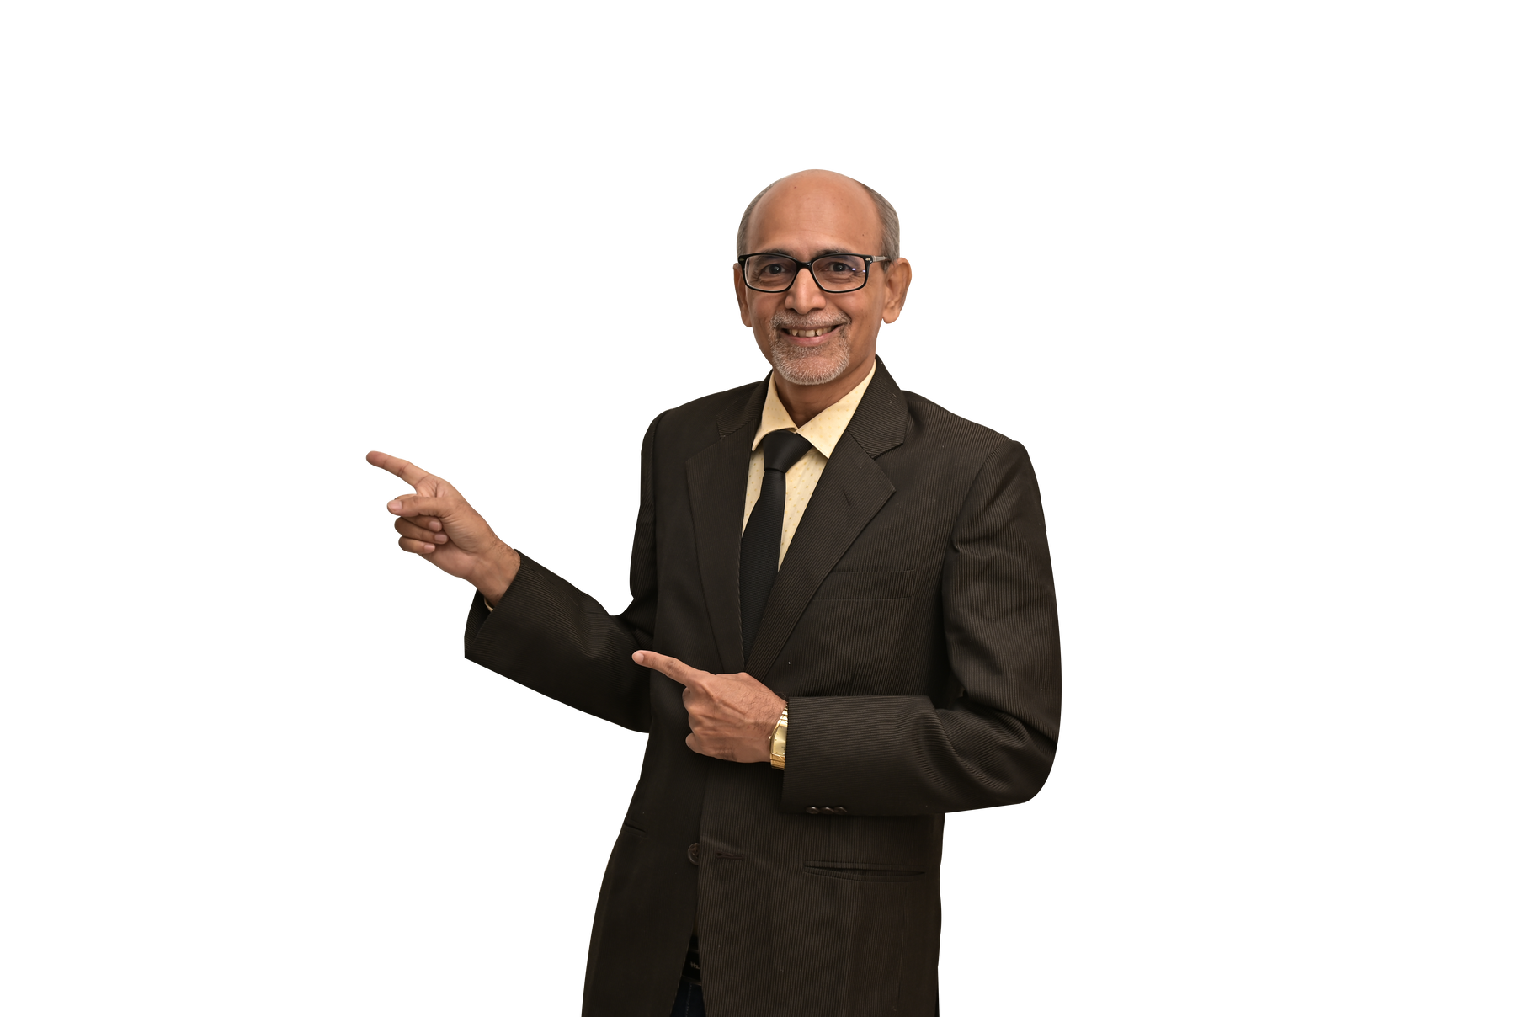
  FluentLingua
  presents
English for Life
& Business
  by Dharmendra Sheth
  MA, PhD (English)
www.fluentlingua.com
  9825442418

Slide 2


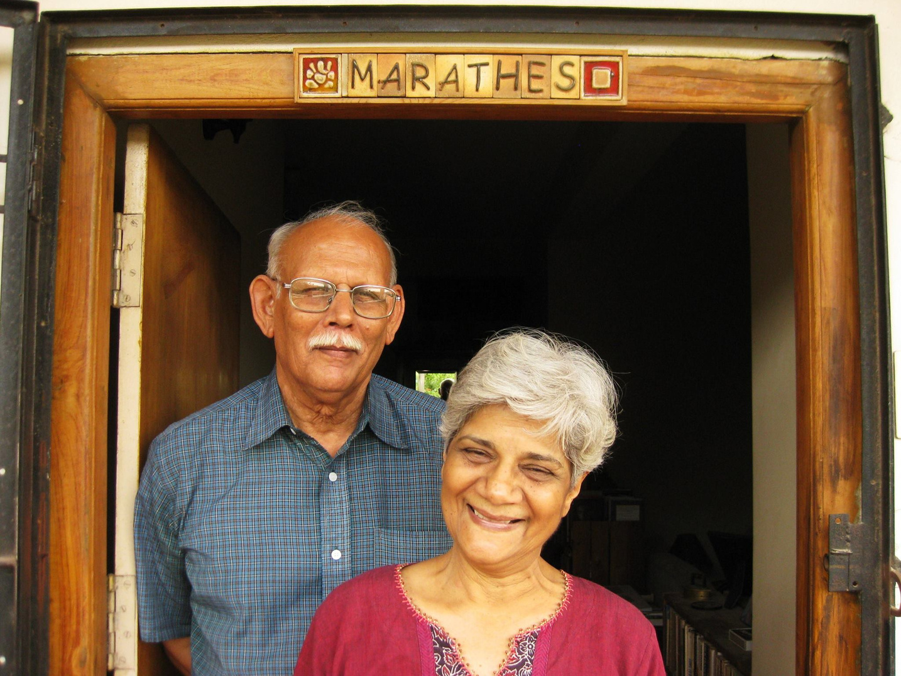


My Teachers
Late Dr Sudhakar Marathe
Mrs Meera Marathe

Slide 3


CAVEAT
A drop in the ocean!

Slide 4


Slide 5








Contents
MYTHS
ACTIVITIES
DISCUSSION
+...
ABANDON

Slide 6
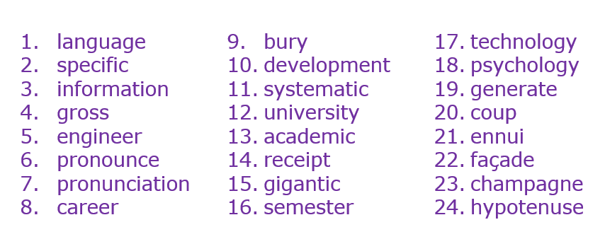
Let’s try!

Slide 7


The Goal of Communication
A
B
C

Slide 8



Why this presentation?
Some examples...
  While looking for a seat...
  While congratulating...
  While introducing...

Slide 9


Let’s speak the following words.
language specific information gross engineer pronounce pronunciation career | bury development systematic university academic receipt gigantic semester | technology psychology generate coup ennui façade champagne hypotenuse
LOOK
FEEL
SMELL
SOUND
TASTE
Sound
Stress
Rhythm
Tune
Style

Slide 10
Yes!

Slide 11
Fantastic

Slide 12


Slide 13

A COMA
A COMMA

Slide 14

Does a comma
(or any punctuation mark)
matter in real-life business?

Slide 15
A million dollar comma case
The dispute in Canada between Rogers Communications and Bell Aliant. The argument turns on a single comma in the 14-page contract. The answer is worth 1 million Canadian dollars ($888,000).

Slide 16
A 5m dollar comma case
The lack of one Oxford comma in a Maine state law just cost Oakhurst Dairy $5 million in overtime pay.
Note: An Oxford, or serial, comma is the last comma in a list; omitting it can lead to some confusion.

Slide 17
Spot the errors!
Myself Mr Nilesh. I am working in this company since six years. According to me, my English is more better than my boss. Because I practice it everyday. My teacher is elder then me. I can not spend more time in it but yesterday I could study for ten hours. I look forward to learn more.

Slide 18
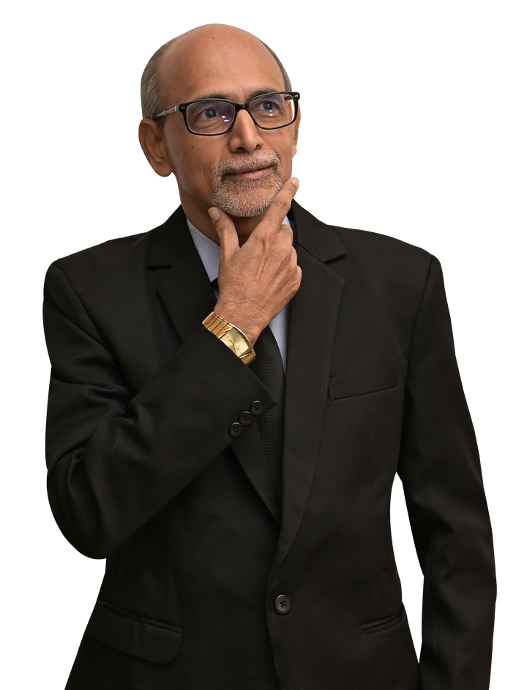
How many
errors
have you spotted?

Slide 19
Spot the errors!
Myself Mr Nilesh. I am working in this company since six years. According to me, my English is more better than my boss. Because I practice it everyday. My teacher is elder then me. I can not spend more time in it but yesterday I could study for ten hours. I look forward to learn more.

Slide 20
Spot the errors!
My name is Nilesh. I have been working in this company for six years. To my mind, my English is better than my boss's. Because I practise it every day. My teacher is older than me. I cannot spend more time on it but yesterday I was able to study for ten hours. I look forward to learning more.

Slide 21
What to study and how?

Slide 22

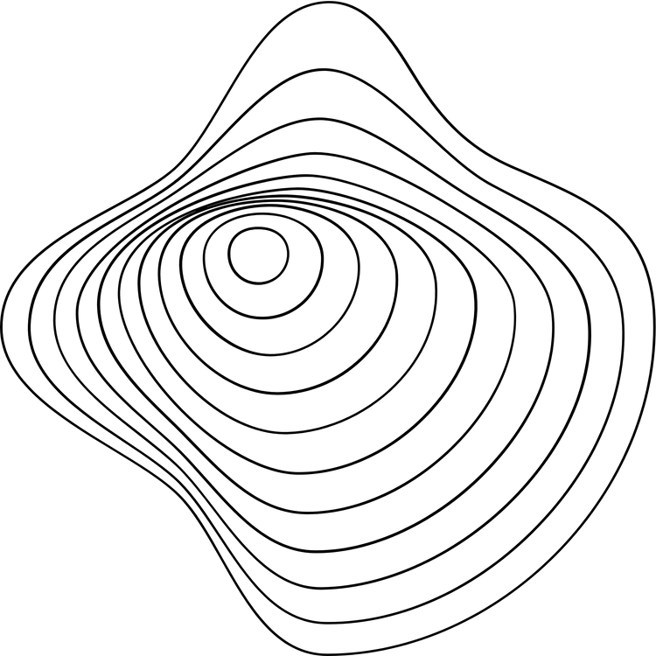
Systems
1
2
3
  vocabulary
  Grammar
  Prounuciation
Words

Slide 23




One needs to Hone one's editing skills... eternally.
  What is editing?

Slide 24








In a nutshell
Add
Budge
Change
delete

Slide 25


Politeness Matters!
  I got your email yesterday.
  How can we accept your proposal?
  We want our payment. Send us
immediately or we will sue you.

Slide 26
Stress Matters!
I never said she stole my money.
  I never said she stole my money.
  I never said she stole my money.
  I never said she stole my money.
  I never said she stole my money.
  I never said she stole my money.
  I never said she stole my money.
  I never said she stole my money.

Slide 27
Please answer immediately.

Slide 28
The opposite of ‘switch on’ is…

Slide 29
The opposite of ‘turn on’ is…

Slide 30
The opposite of ‘put on’ is…

Slide 31
Letters and Sounds
A T U

Slide 32
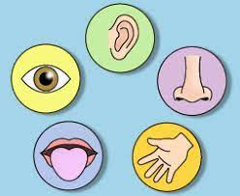
A
Simple
Activity

Slide 33
Arrange the following sensory words as instructed.
fragrant, dark, soft, gloomy, round, sweet, tiny, bumpy, rotten, dry, hard, loud, rough, slimy, tangy, smooth, soft, beautiful, sweet, fresh, musty, blaring, crisp, shiny, bitter, fluffy, delicious, fresh, hot, red, salty, noisy, sour, crunchy, spicy, quiet
LOOK
FEEL
SMELL
SOUND
TASTE
LOOK
FEEL
SMELL
SOUND
TASTE

Slide 34
How does it...?
LOOK
FEEL
SMELL
beautiful, dark, fluffy, gloomy, red, round, shiny, tiny
bumpy, dry, hard, hot, rough, slimy, smooth, soft
fragrant, fresh, rotten, musty, sweet
SOUND
TASTE
blaring, crisp, crunchy, loud, noisy, quiet, soft
bitter, delicious, fresh, salty, sour, spicy, sweet, tangy

Slide 35
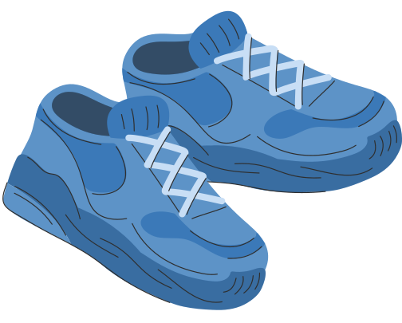



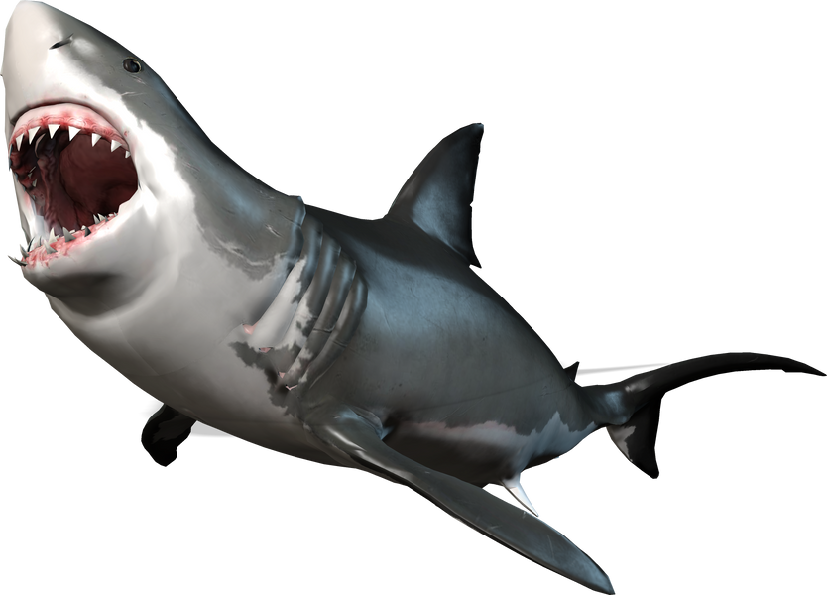

Let's prove our creativity!
1
2
3
  Clean your shoes.
  Describe
  A difficult task

Slide 36
Let's prove our creativity!
1
2
3
  Clean your shoes.
  Describe
  A difficult task

Slide 37

CLEAN
Task 1
Rewrite "Clean your shoes" without using the words "clean" and "shoes".
Look at
these!

Slide 38
CLEAN
  Brighten up your footwear.
  Spruce up your waders.
  Your boots need polishing.
  Your oxfords could do with a bit of spit and polish.
Look at
these!

Slide 39
Let's prove our creativity!
1
2
3
  Clean your shoes.
  Describe
  A difficult task

Slide 40

THE SUN
Task 2: Complete the following.
He looked up. The sun ...
Look at
these!

Slide 41
THE SUN
part 1
He looked up. The sun ...
  The sun was engulfed by the clouds.
  The sun was shining with all its might to make its presence felt.
  The sun dominated the sky.
  The sun was crimson.
Look at
these!

Slide 42
THE SUN
part 2
He looked up. The sun ...
5. The sun in all its effulgence chased away the darkness.
6. The sun broke the clouds into different shapes and figures.
7. The sun was delicious.
Look at
these!

Slide 43
Let's prove our creativity!
1
2
3
  Clean your shoes.
  Describe
  A difficult task

Slide 44


DIFFICULT
Task 3: Convey the following message using an "as...as..." structure.
It was a difficult task.
Look at
these!

Slide 45
DIFFICULT
part 1
  It was like climbing Mount Everest without oxygen.
  It was like swimming with sharks without being eaten alive.
  It was like emptying an ocean with a teaspoon.
Look at
these!

Slide 46



DIFFICULT
part 2
4. It was like filling a bucket with water using a sieve.
5. It was like trying to put the toothpaste back in the tube.
6. It was like looking for a needle in a haystack.
Look at
these!

Slide 47
Some additional ideas/activities.
  A dog was barking while chewing bark.
  He writes with his right hand.
  She left, and then only he was left.
  They are like two peas in a pod.
  He was alarmed, scared and terrified.
  You can crawl, leap, march, or skip.

Slide 48
& some more...
7. The tiny may float, the huge may sink.
8. There's a bookshelf in the classroom.
9. He is pro-anti-internationalisationism.
10. The mind is an ocean.
11. Take off your shoes before the take-off.
12. ...then suddenly the penny dropped.

Slide 49


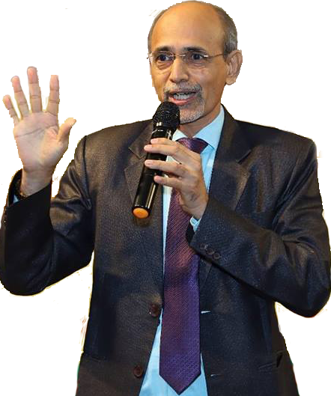
&
Goodbye
Thank
you!
www.fluentLingua.com

Slide 50



fluentlingua@gmail.com
Email
Please Get In Touch, will you?
@fluentlingua
IG
fluentlingua
FB
www.fluentlingua.com
Website
9825442418
Phone

